Slide 1


Slide 2
Voices of Silence
Gyuri, róka, Enikő & Tiya

Slide 3
Live Demo

Slide 4
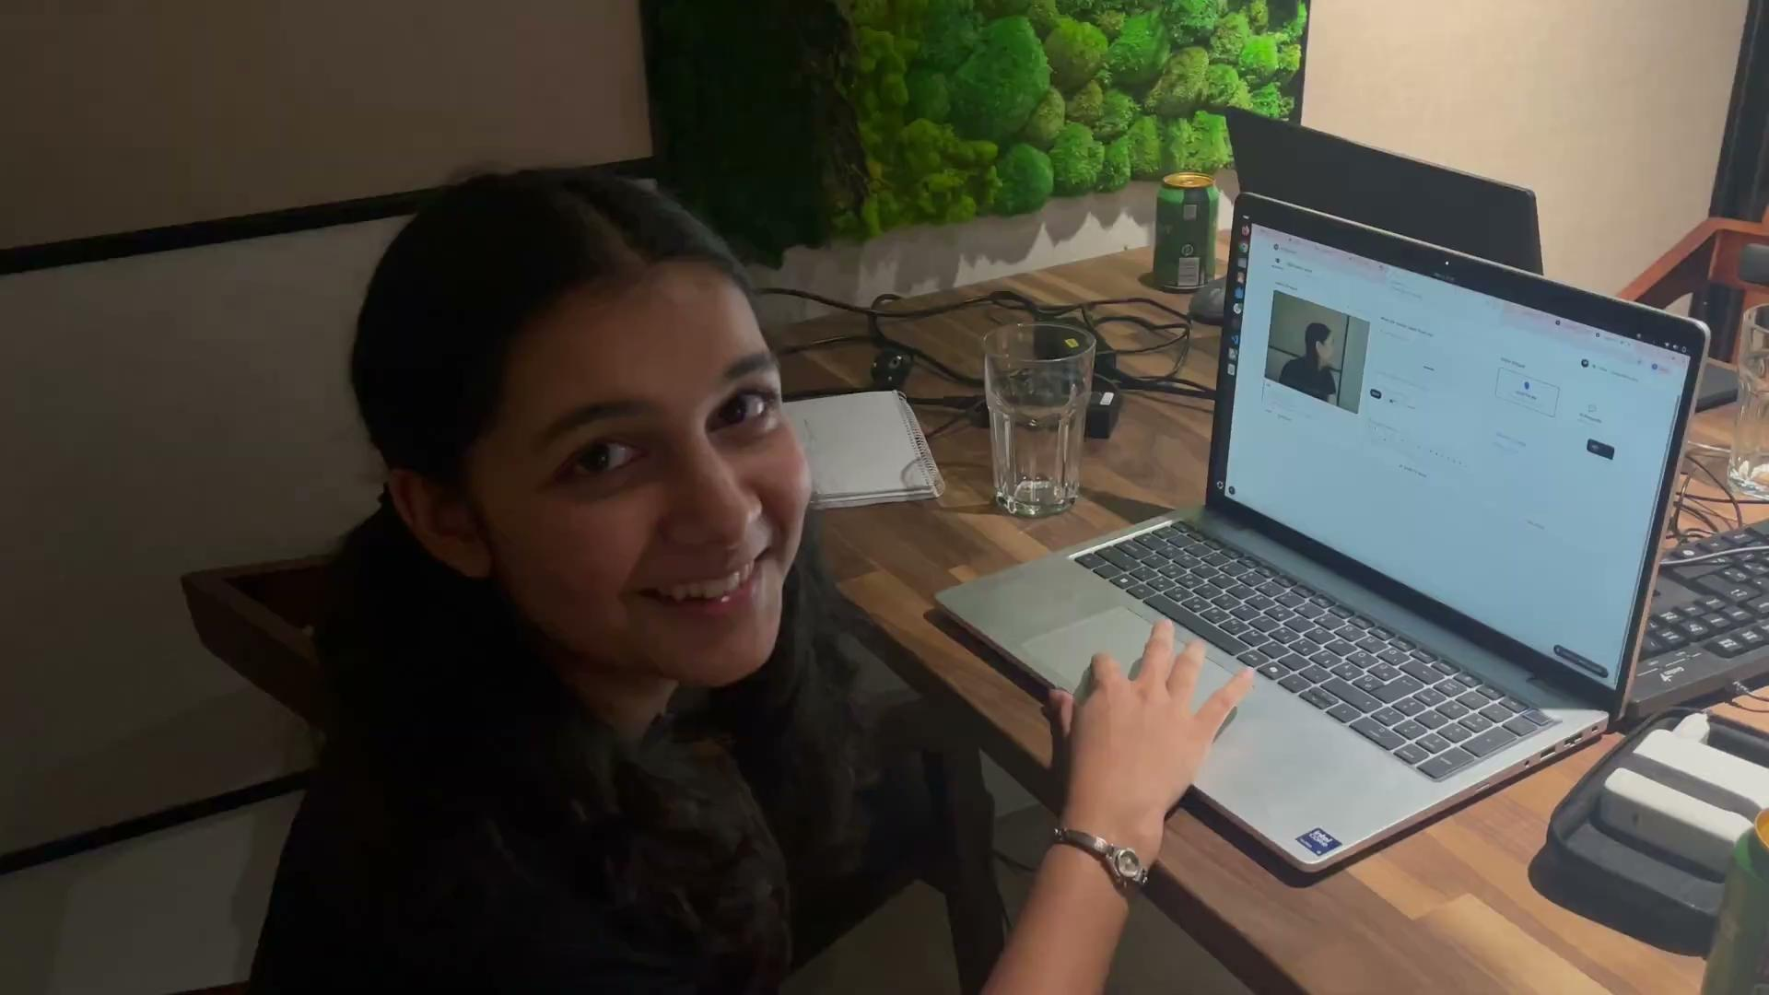

Slide 5


Our application is live at
https://asl-project-iota.vercel.app

Slide 6
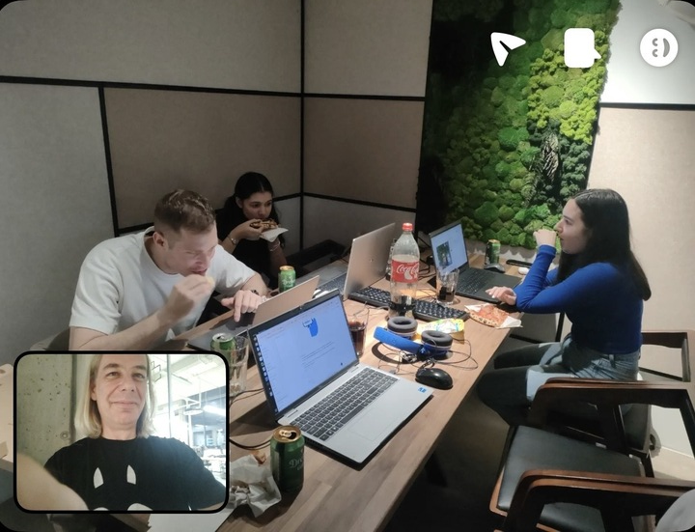
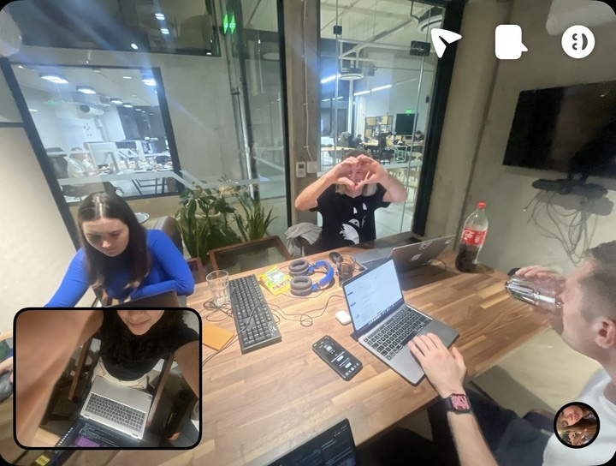
How the past 3 hours were spent…

